Slide 1
Evaluation of
3D Human Pose Estimation with 2D Marginal Heatmaps
Original Paper:
3D Human Pose Estimation with 2D Marginal Heatmaps
Aiden Nibali, Zhen He, Staurt Morgan, Luke Predergast
2019 IEEE WCACV
Alberto Fung
Simon Badgett
COSC6373
May 9, 2019
Notes:
1

Slide 2
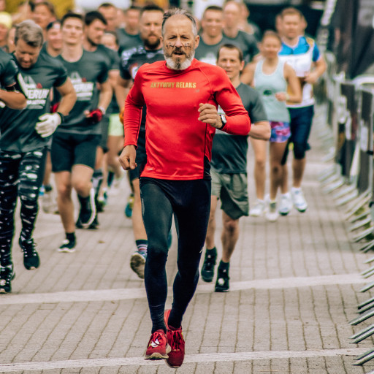
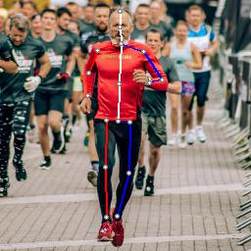
Review – Problem Statement
Input
Image of a Person
Output
17 Key Joint Locations

Slide 3
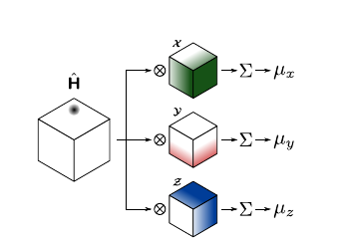
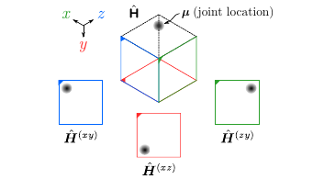
Review – Proposed Contributions from Paper
Use Marginal Heatmap
3D pose estimation by predicting three (3) two-dimensional marginal heatmaps per joint
VS
Volumetric Heatmap
Marginal heatmap
3

Slide 4
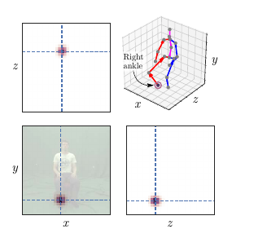
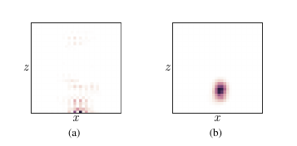
Review – Proposed Contributions from Paper
Regularization
Add regularization term to soft-argmax loss function
Explicitly guides predicted joint heatmaps to a spherical Gaussian distribution
Improves visual coherence of predicted heatmaps
4

Slide 5
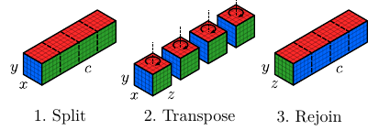
Review – Proposed Contributions from Paper
Architecture with Axis Permutation
Manipulates activations to account for discrepancy between input and output space
Allows the model to aggregate depth cues into feature maps, which will then become pixel values along the z-axis

Slide 6
This Project’s Contributions
Custom image and batch images as input
./infer.py --model <model location> --mode i --path <image path>
./infer.py --model <model location>--mode d --path <dir path>
Video as inputs and output
./infer.py --model <model location> --mode v --path <video path>
Export output at Maya ASCII and ATOM format
Automatic as part of new output
Qualitatively Evaluate Robustness of pre-trained model

Slide 7
Robustness Evaluation
Pretrained model already avaliable
Qualitative Evaluation (no annotations)
Image Categories: {position, diversity, difficult poses, limb loss, non-Humans, occlusion and other effects (misc)}
Custom images + Images scraped from the internet
Examine results in 3D space
7
Notes:
7

Slide 8
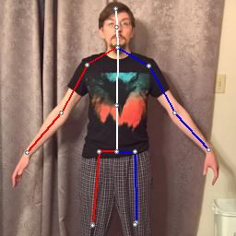
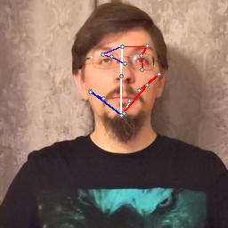
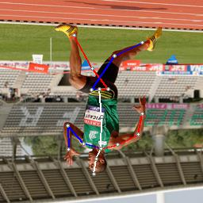
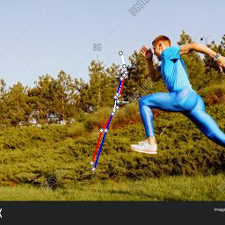
Position
Images of individuals in different position, scale, orientation, and crops along the image frame
Observations:
Subject of interest in the center frame
Close to eye level
> half body in frame
Rotational invariant (as long as it is not upside-down)
8
Notes:
8

Slide 9
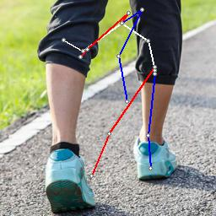
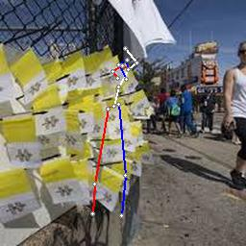
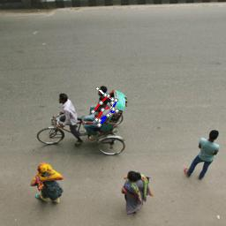
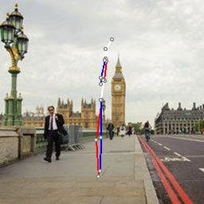
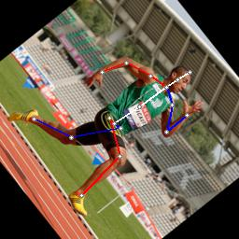
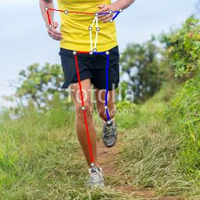
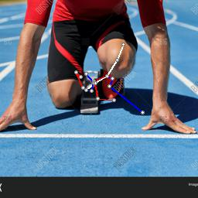
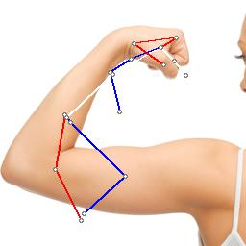
Subject Must be in Frame and Centered
9
Notes:
9

Slide 10
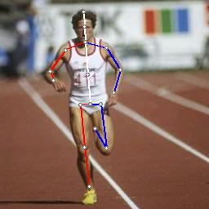
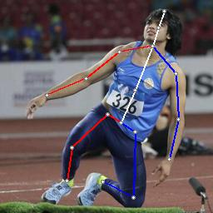
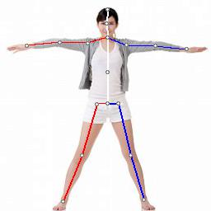
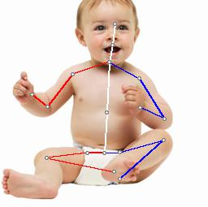
Diversity
Images of individuals in from different ethnicity, age, body size
Observations:
Issues with infants and children
Invariant to ethnic diversity, body sizes
10
Notes:
10

Slide 11
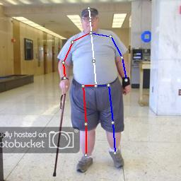
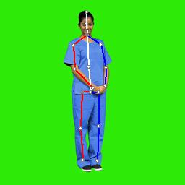
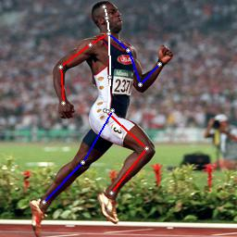
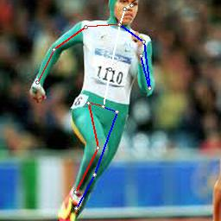
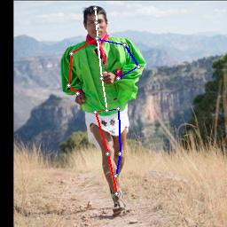
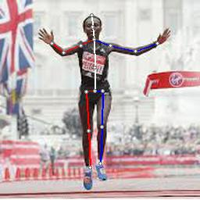
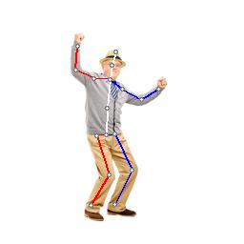
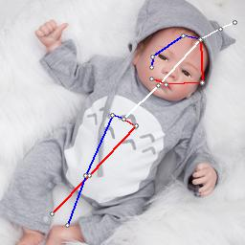
Diversity
11
Notes:
11

Slide 12
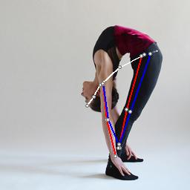
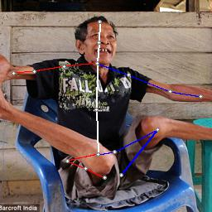
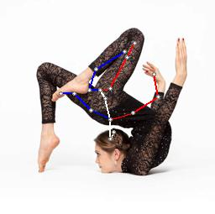
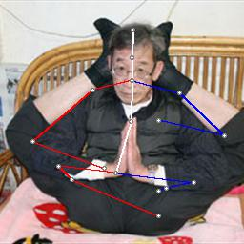
Extreme and Unnatural Poses
Images of individuals in difficult poses (extreme yoga position, contortionist, uncommon point of views)
Observations:
Issues with extremely unnatural positions
Success for difficult yoga poses
Possible limitations due to model only fitting to 17 joints
12
Notes:
12

Slide 13
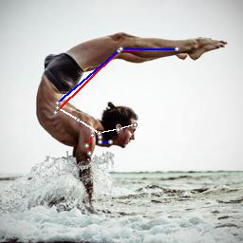
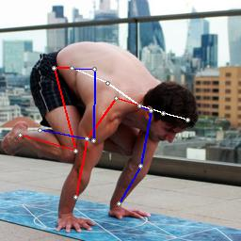
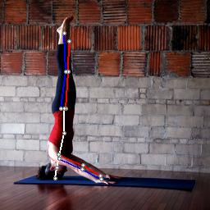
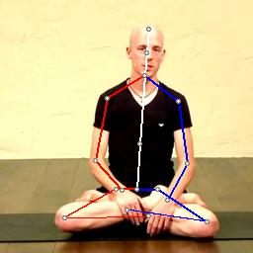
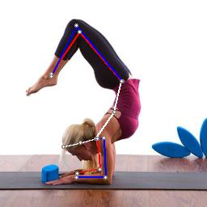
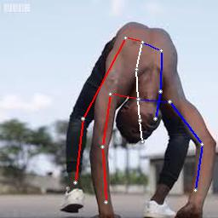
Difficult Yoga Poses
13
Notes:
13

Slide 14
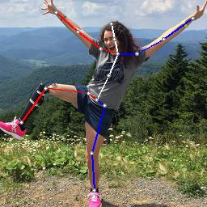
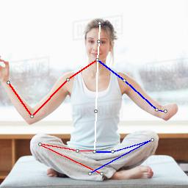
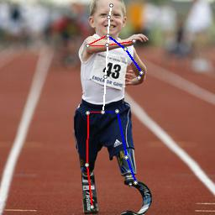
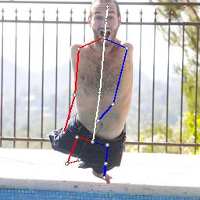
Individuals with Limb Loss
Images of individuals in with limb loss
Observations:
Joints inferred at end of limb
Invariant to prosthetics
Missing limbs are assume to be occluded by body
14
Notes:
14

Slide 15
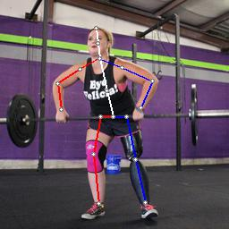
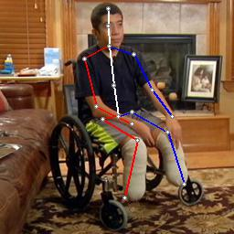
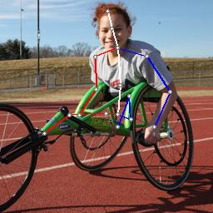
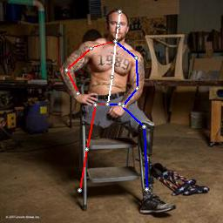
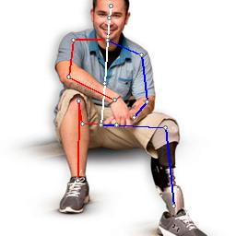

Individuals with Limb Loss
15
Notes:
15

Slide 16


Individuals with Limb Loss
Observations:
Joints for missing limbs assigned to other features in image
Model attempts to find all joints, even if not in frame
16
Notes:
16

Slide 17




nonHUMANS
Images of animals, dolls, action figures, mannequins
Observations:
Able to infer figurines & mannequins but not primates!
17
Notes:
17

Slide 18






nonHUMANS
18
Notes:
18

Slide 19




Occlusion and Other Effects
Images of individuals under occlusion, in crowd, low lighting, and others synthetic effects
Observations:
Preference for individual in the center, invariant to an individual’s direction
Able to infer under low lighting conditions
Model not affected by mocap markers
Occluded joints are still predicted
19
Notes:
19

Slide 20








Occlusion, Low Lighting, Noise
20
Notes:
20

Slide 21








Occlusion
21
Notes:
21

Slide 22


Results in 3D Space
Original Results from MargiPose

Slide 23


Depth Issues in 3D

Slide 24


Results in 3D Space

Slide 25


Results in 3D Space

Slide 26


Results in 3D Space
“Smooth Criminal” Pose

Slide 27
Summary of Robustness Evaluation
Invariant to :
Rotation (as long as not upside-down)
Ethnic diversity, various body size, prosthetics
Figurines, mannequins
Difficult poses (like yoga)
High levels of occlusion
Difficult lighting conditions

Slide 28
Summary of Robustness Evaluation
Limitations:
More than one person of interest
Person of interest far close to center of frame
Requires > half body
Infants, young children, extreme and unnatural poses
“Must output 17 joints”
3D Space:
Issues with depth and scaling
Skewed depth along z-axis (greater for frontal images)
Scaling effects were greater in images with children

Slide 29

Further Applications
29
Notes:
29

Slide 30


Gait Analysis
Normal Gait
Leg Swing Angle (Flexion and Extension) ~ 30degs
Right/Left Leg symmetrical but out of phase
30
Notes:
30

Slide 31


Gait Analysis
Parkinson’s Gait (Shuffle Gait)
Very short hip flexion
Possible Asymmetry (dominant leg)
High step frequency
31
Notes:
31

Slide 32


Gait Analysis
Hemiplegic Gait
Asymmetrical Pattern
Impaired swing of one leg at the hips
32
Notes:
32

Slide 33

Motion Capture and Animation
ATOM (Animation Transfer Object Model)
17 Joint Skeleton exported from MargiPose
Existing humanoid 3D mesh
Poses exported as Key-frame animation
33
Notes:
33

Slide 34

Motion Capture and Animation
ATOM (Animation Transfer Object Model)
Forward and Inverse Kinematics
Lacks Joint Orientation
Translational Information, not Rotational
34
Notes:
34

Slide 36
Lesson Learned - Alberto
Getting code to run properly despite having pretrained model is non-trivial
Making modifications to someone else’s code is frustrating
Time management and constant team communication is important
Increased PyTorch framework skills
Gained an appreciation for GPU acceleration for inferencing
Video inferencing

Slide 37
Lesson Learned - Simon
Time management and constant team communication is important
Increased PyTorch framework skills
Prediction of 3D space from 2D images is extremely difficult
Increased skills in application of forward and inverse kinematic for animation modeling
MargiPose and other similar pose estimation algorithms are insufficient to animate a 3D model with mesh

Slide 38
Questions?
References
3D Human Pose Estimation with 2D Marginal Heatmaps
Aiden Nibali, Zhen He, Stuart Morgan, Luke Prendergast
La Trobe University, Australia
arXiv:1806.01484
Code Repository
https://github.com/afung-git/margipose

Slide 39


More Fun Videos

